Slide 1
How and Why
to do
Men’s Health
Myles Spar, MD, MPH
Southern California Men’s Medical Group
Tack180
Simms-Mann Health and Wellness Center, Venice Family Clinic
UCLA School of Medicine

Slide 2
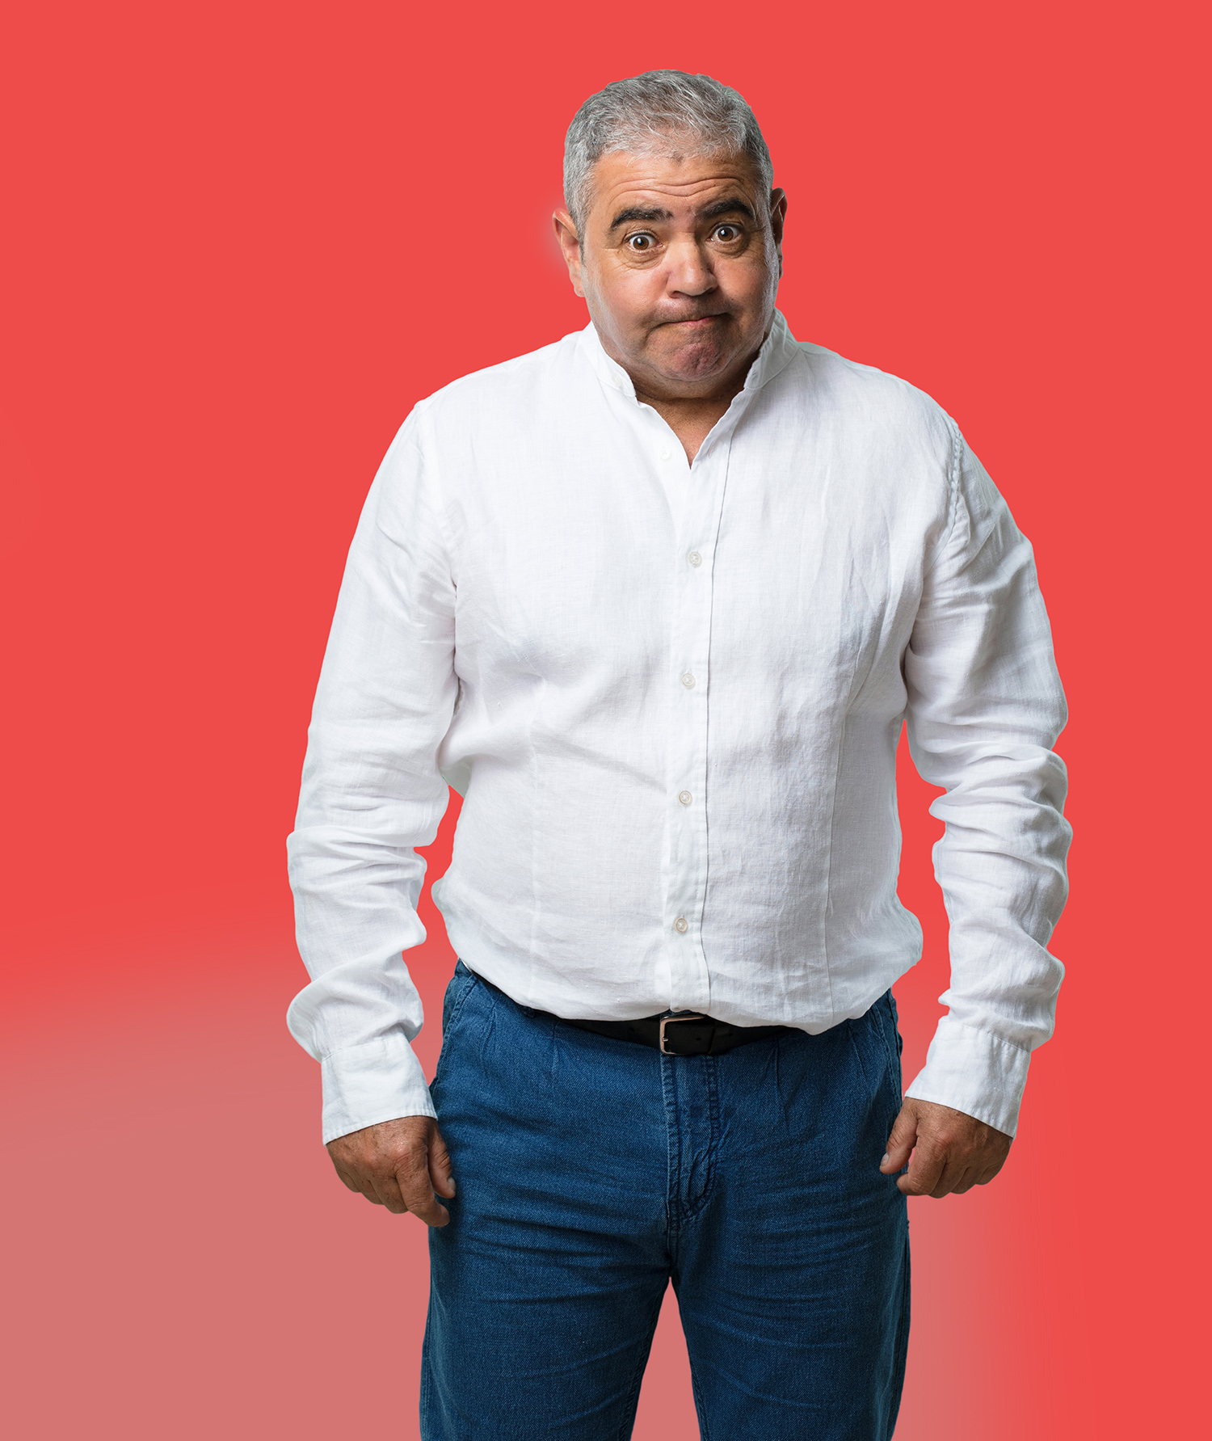
Why do we need a
unique approach
to men’s health?

Slide 3
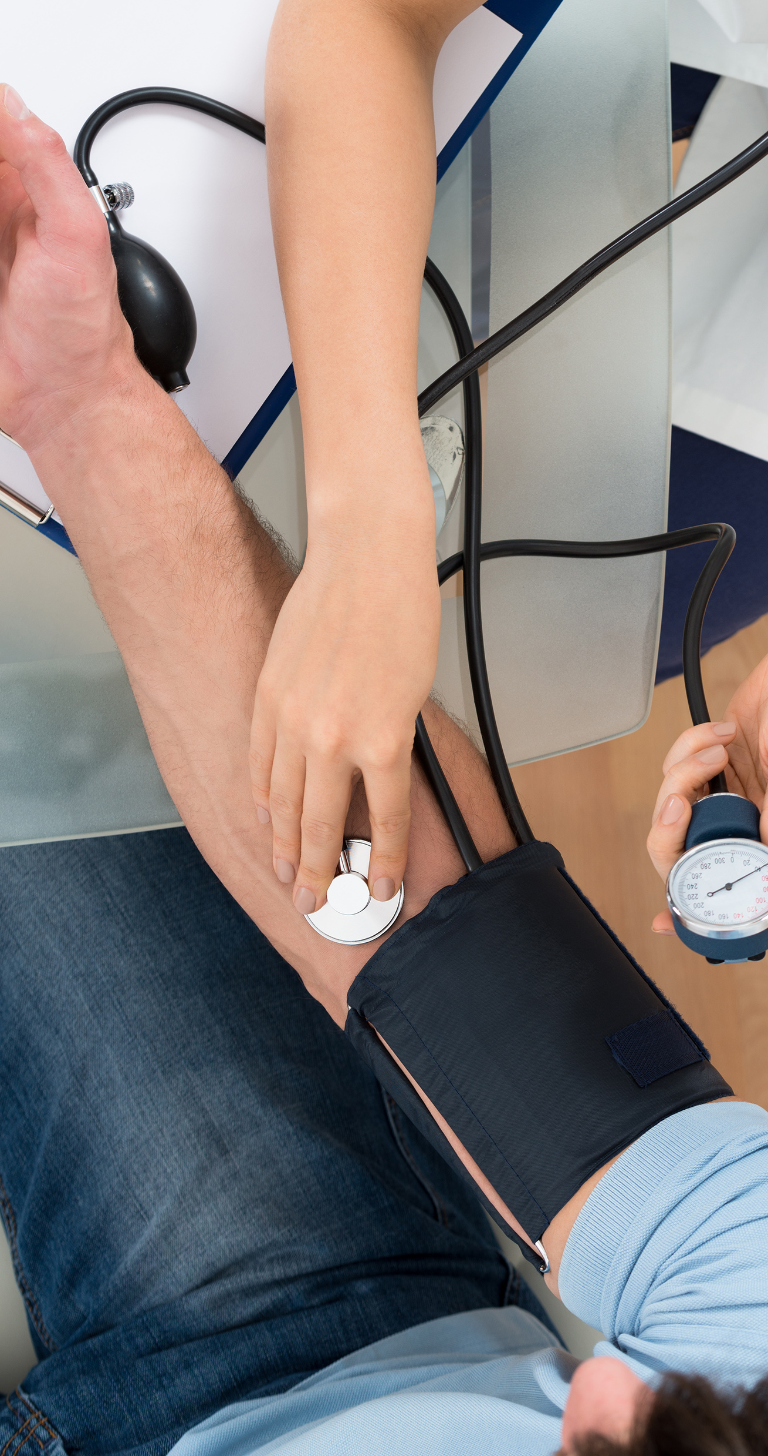
of top 10 causes of death in US, men are winning in 9 of them,
and 80% are preventable
Simply being a man increases one’s risk of death
Men respond differently to messaging around health
Men’s health is about more than the sum of all health care that is not specific to women

Slide 4
PROJECTED GROWTH IN POPULATION WITH CHRONIC CONDITIONS
History of Stroke
Diabetes
Arthritis
Total US POPULATION
Asthma
Dall T M et al. Health Aff 2013; 32:2013-20.

Slide 5
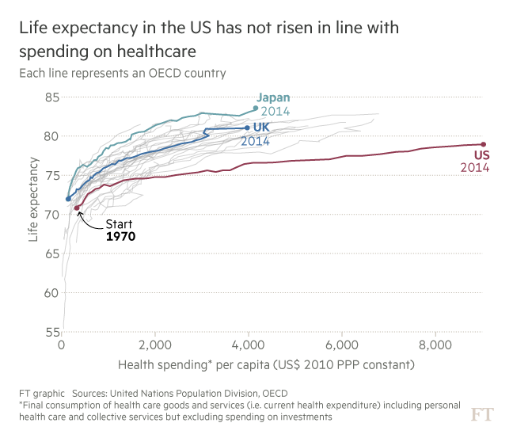
The U.S. is the only developed country where life span has been decreasing for the last 2 years

Slide 6
Behavior change adds years to life
5 habits that add 13 years to life per new study
NO SMOKING
MODERATE
ALCOHOL
REGULAR
PHYSICAL ACTIVITY
HEALTHY DIET
HEALTHY WEIGHT
Li Y et al. Circulation. 2018;138:345-55. 30 Apr 2018

Slide 7
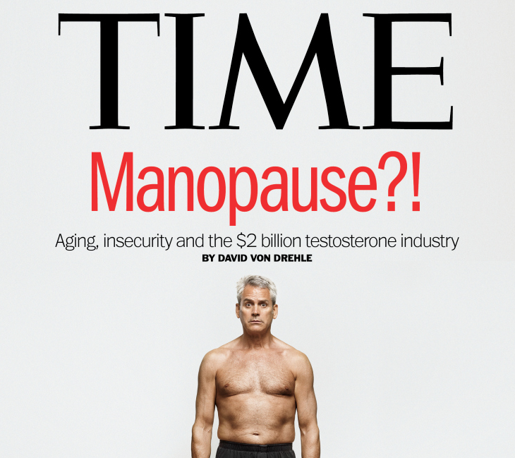
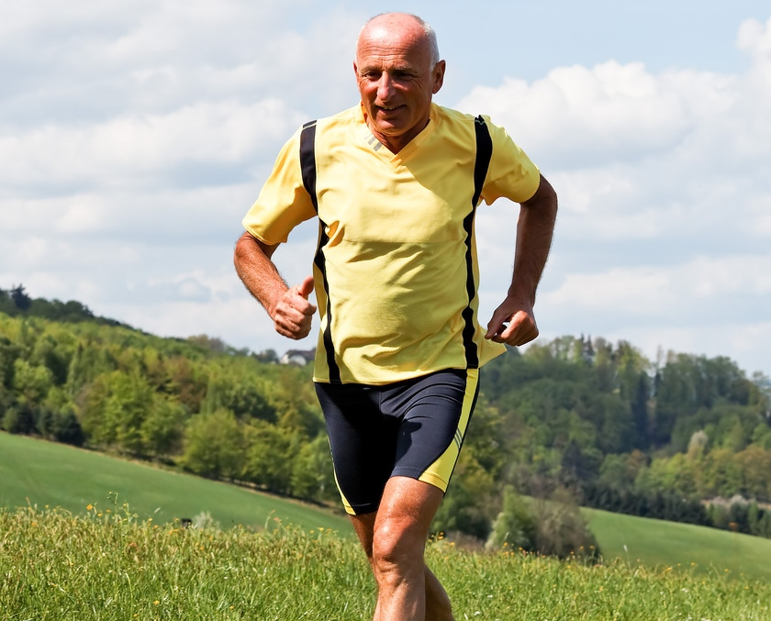
CONDITIONS OF CONCERN FOR MEN’s HEALTH
Prostate health
Testosterone/andropause
High CV
DISEASE RISK
FITNESS
Sexual function issues

Slide 8
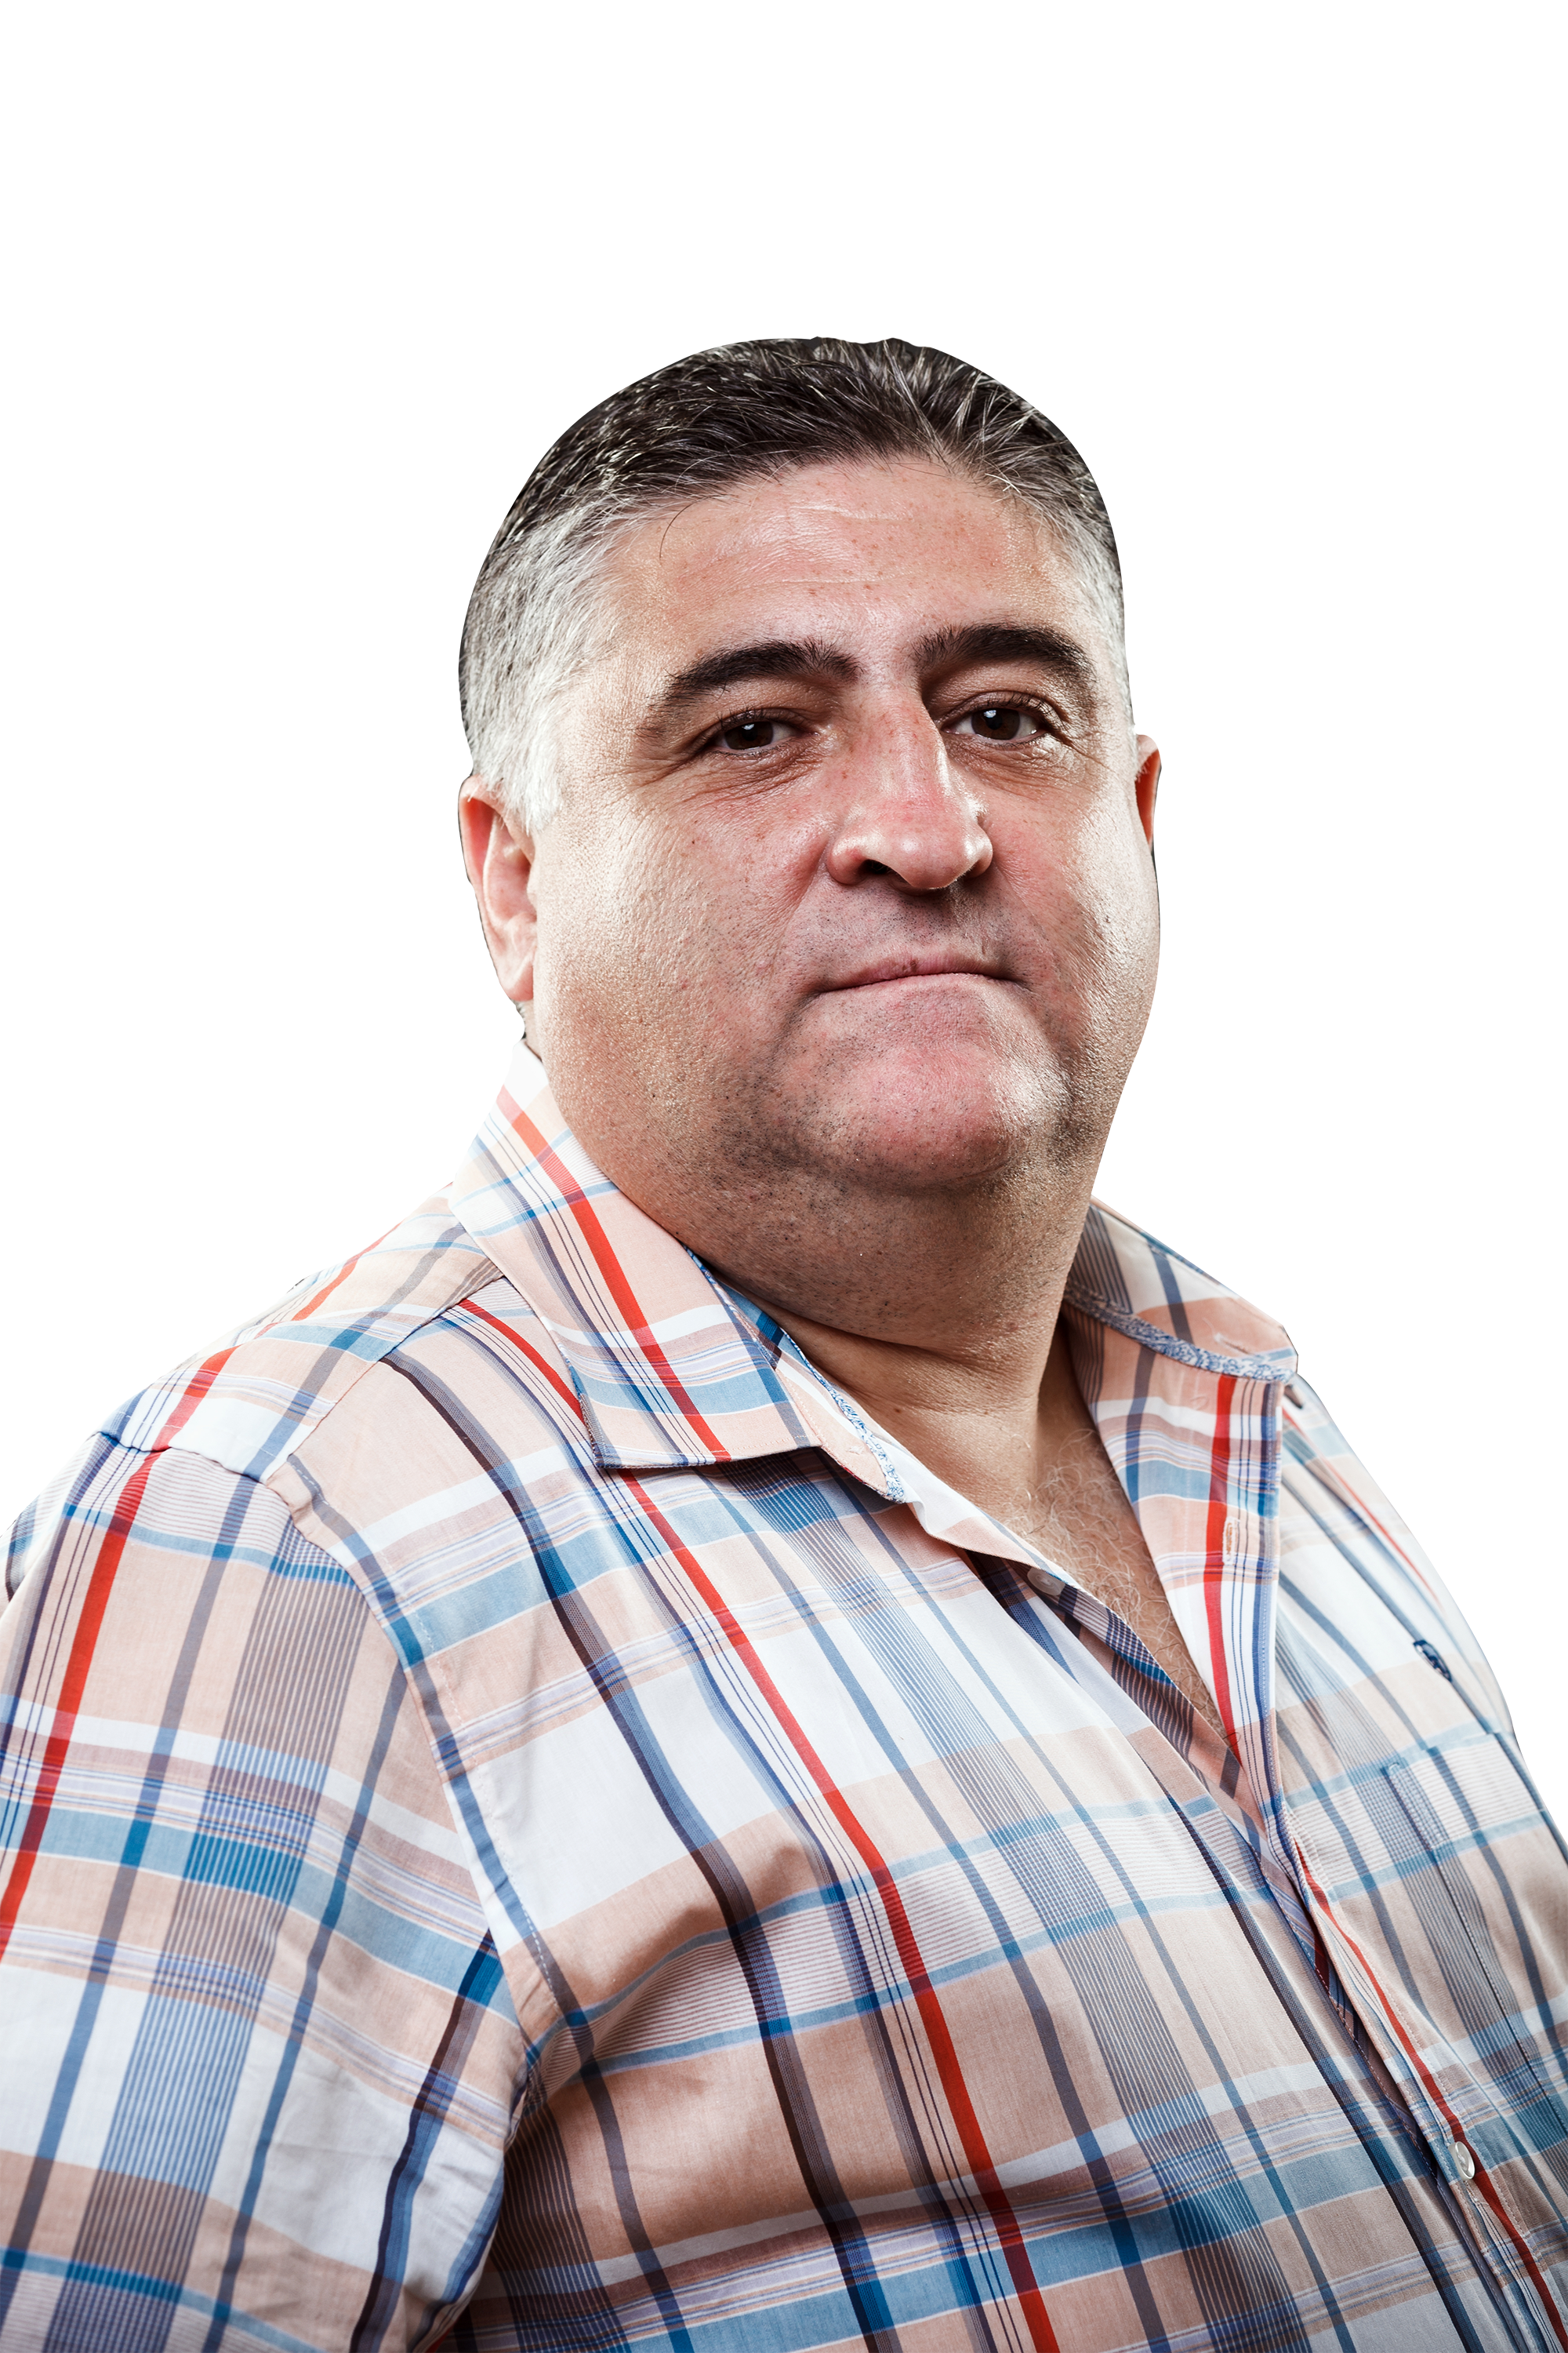
Why we need a unique approach Precision Preventive Medicine :
How do we get
him to change?
PETER
Overweight
44 yo
High blood pressure

Slide 9
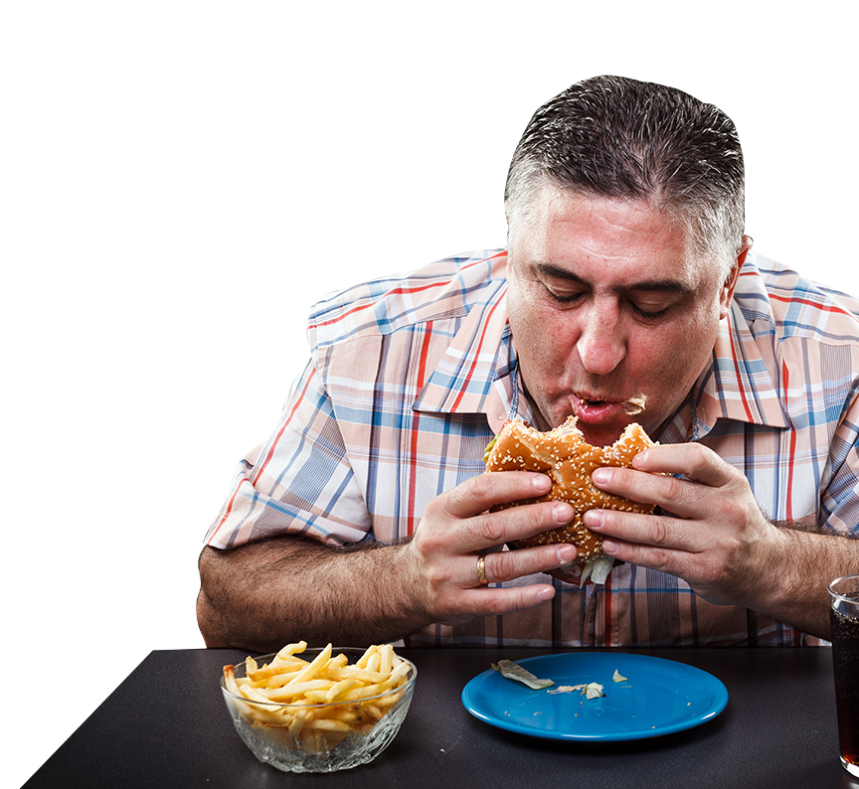
Why we need a unique approach Precision Preventive Medicine :
How do we get
him to change?
PETER, 44 yo
Eats unhealthy
Doesn’t go to Dr.
Doesn’t work out

Slide 10
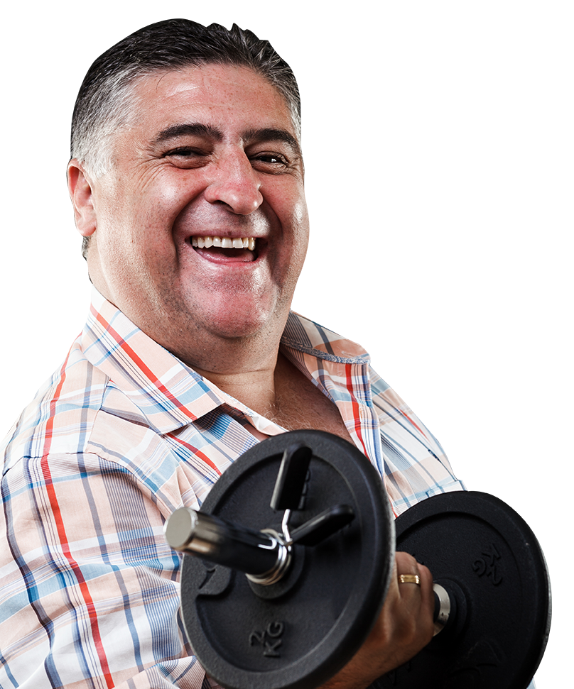
PRECISION PREVENTIVE MEDICINE
1
Identify what matters TO the patient,
not simply what is the matter WITH the patient
2
Establish health status and risks
3
Shared decision making on goals
4
Create personalized health plan
5
Accountability and support

Slide 11
PRECISIONPREVENTIVE MEDICINE

Slide 12
The
Man
TOOLKIT
MEASURE
ID RISK
GOAL SETTING
COMPETITION
COMMUNITY
PURPOSE

Slide 13
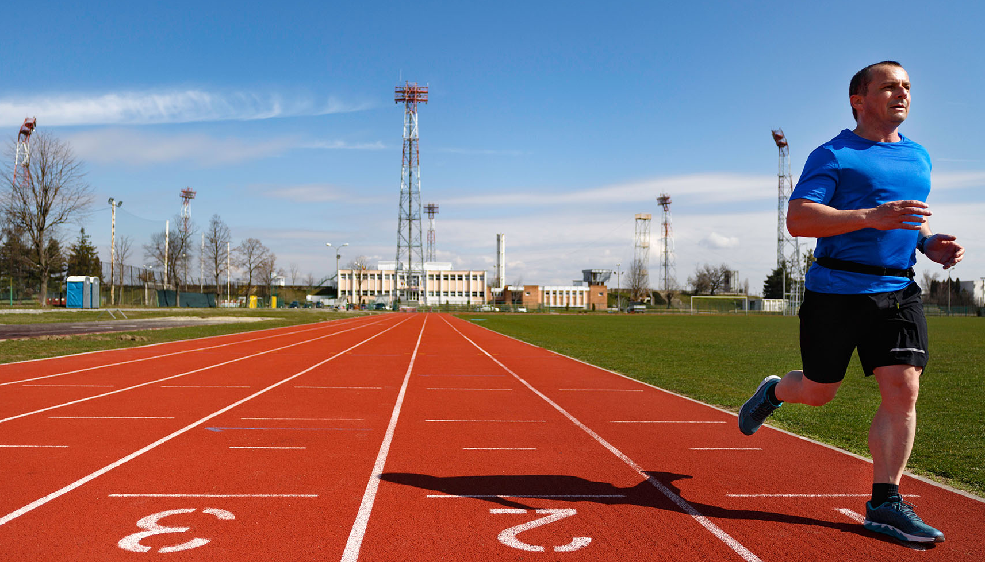
PURPOSE
IS POWERFUL
*Percent decrease in mortality
15%
20%
20%
Quitting smoking
Starting Exercise
Identified Purpose
Ten prospective studies w/ 136,265 participants
Significant assoc between having a higher purpose in life and reduced all-cause mortality (RR= 0.83 [CI = 0.75–0.91], p < .001) and CV events (RR= 0.83 [CI = 0.75–0.92], p = .001). Cohen R et al. Psychosomatic Med, 2016;78(2):122-33.

Slide 15
MOONSHOT
Importance of purpose

Slide 16
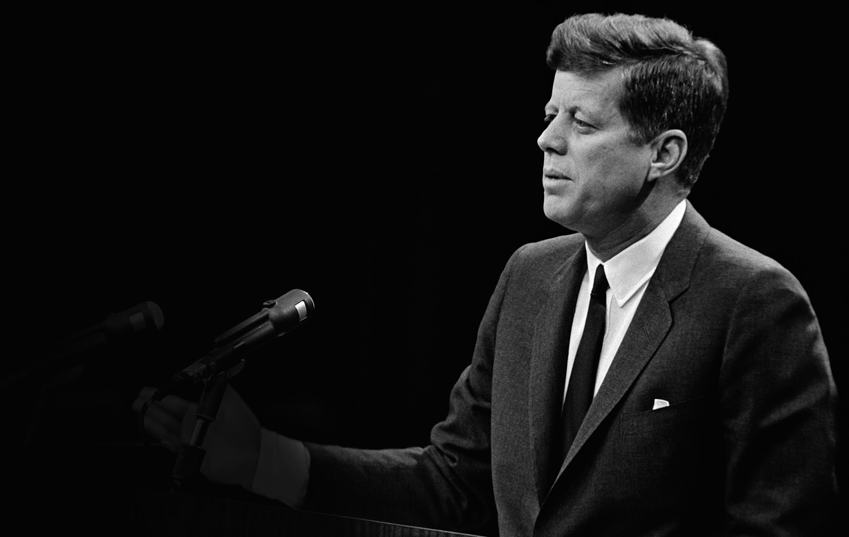
JFK
“Moon Speech”
9/12/62
“We choose to go to the moon," the president said.
"We chose to go to the moon in this decade and do the other things, not because they are easy, but because they are hard, because that goal will serve to organize and measure the best of our energies and skills, because that challenge is one that we are willing to accept, one we are unwilling to postpone, and one which we intend to win.”

Slide 17
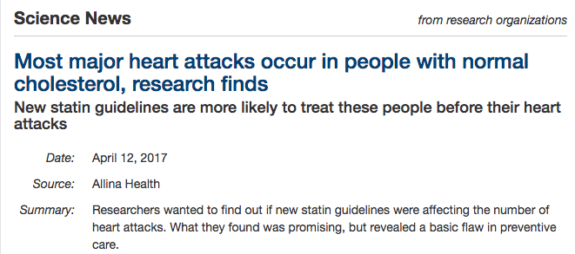
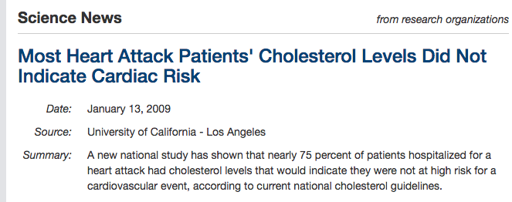

Slide 18
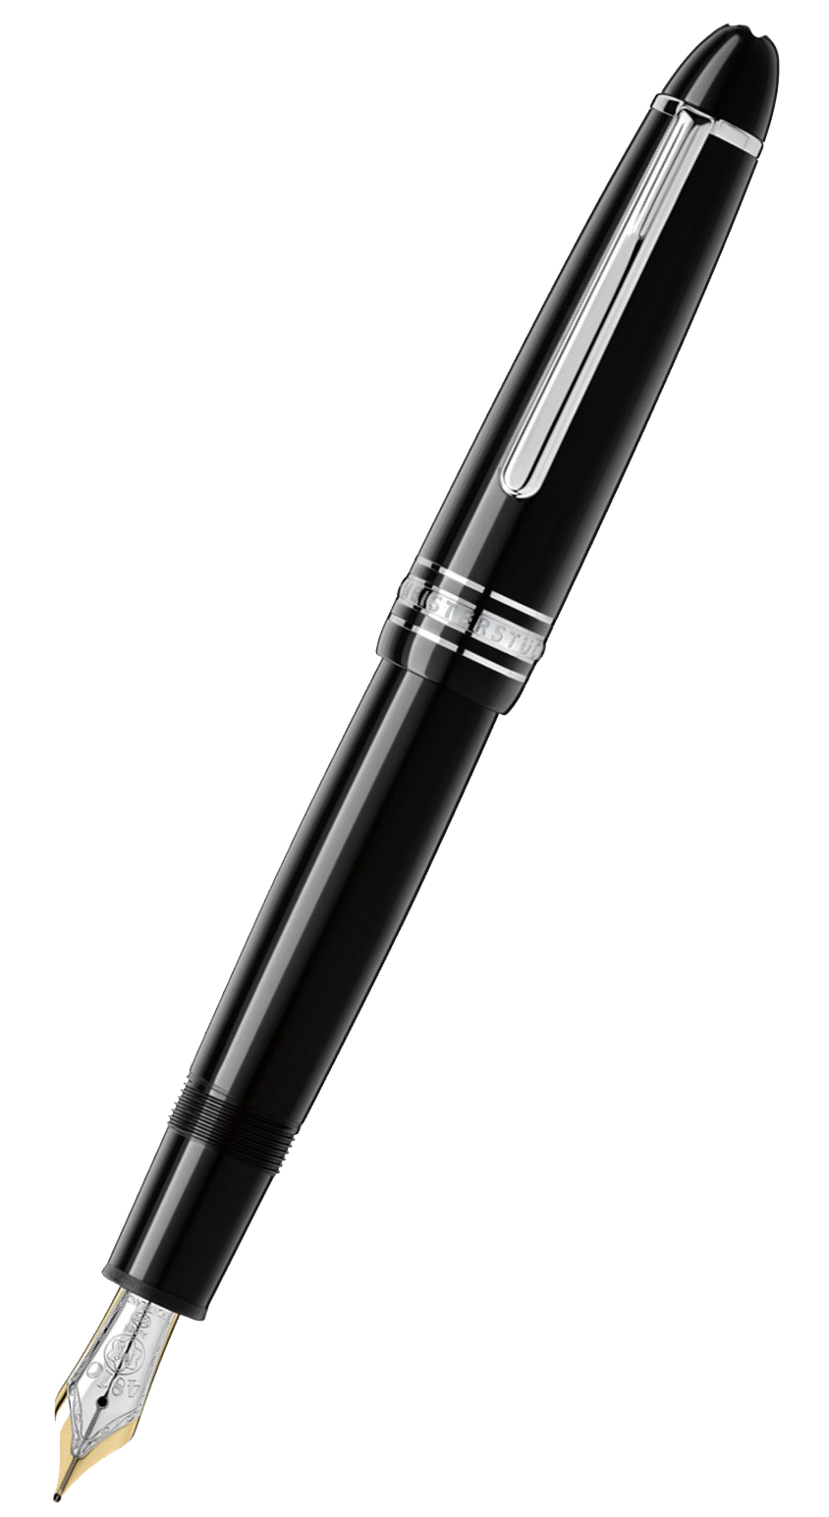
RISK
ASSESSMENT
TESTING DONE
Krogsbøll LT,. et al. Cochrane Database of Systematic Reviews 2012, Issue 10. Art. No.: CD009009. DOI: 10.1002/14651858.CD009009.pub2

Slide 19
RISK ASSESSMENT
GOALS
RISKS
Making changes
Identifying unique risks

Slide 20
The
Man
TOOLkit
MEASURE
ID RISK
GOAL SETTING
COMPETITION
COMMUNITY
PURPOSE

Slide 21
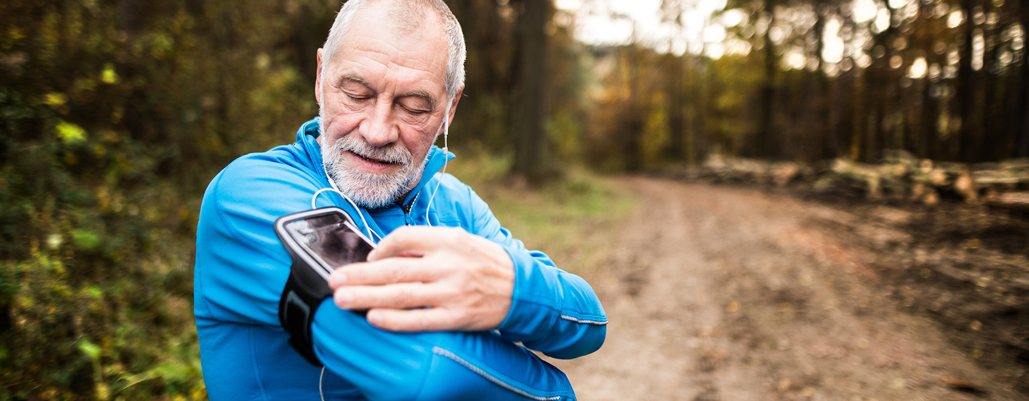
MEASUREMENT

Slide 22
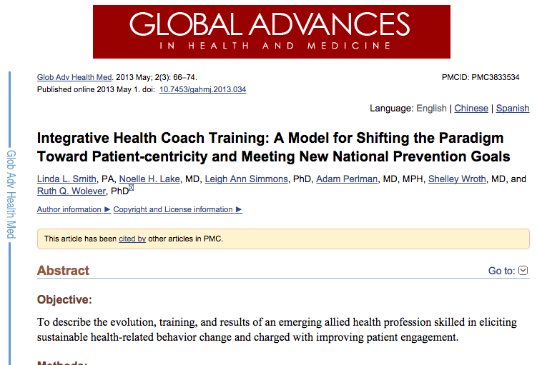
ACCOUNTABILITY AND SUPPORT

Slide 23
YIN&YANG
of competition
& community

Slide 24
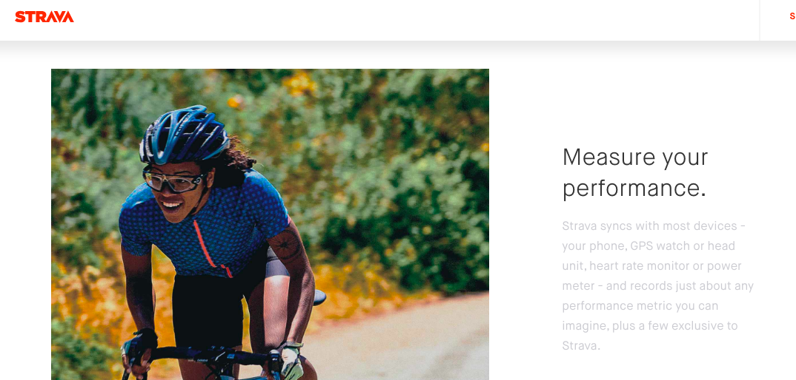

Slide 25
Harnessing the power of purpose
+
identifying unique risks
leads to real incentive to make behavior change

Slide 26
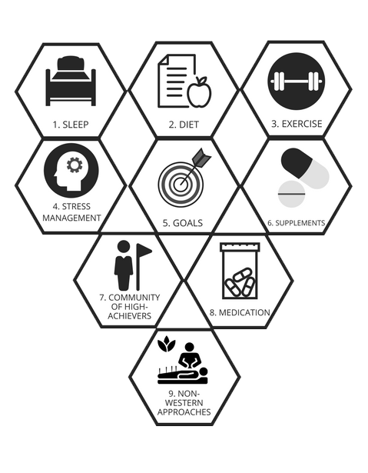
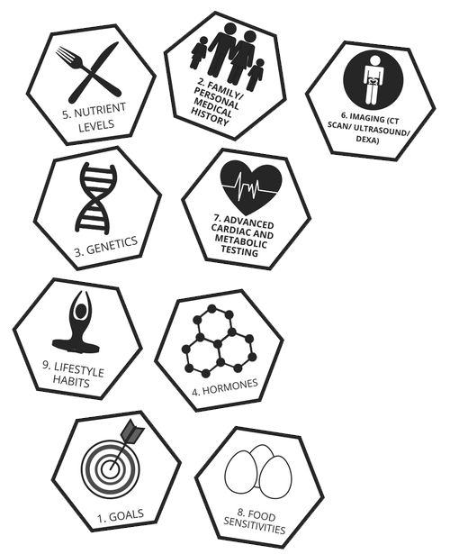
ASSESSMENT
TACK180
STRATEGY
EXPERT
MEDICAL
ANALYSIS

Slide 27
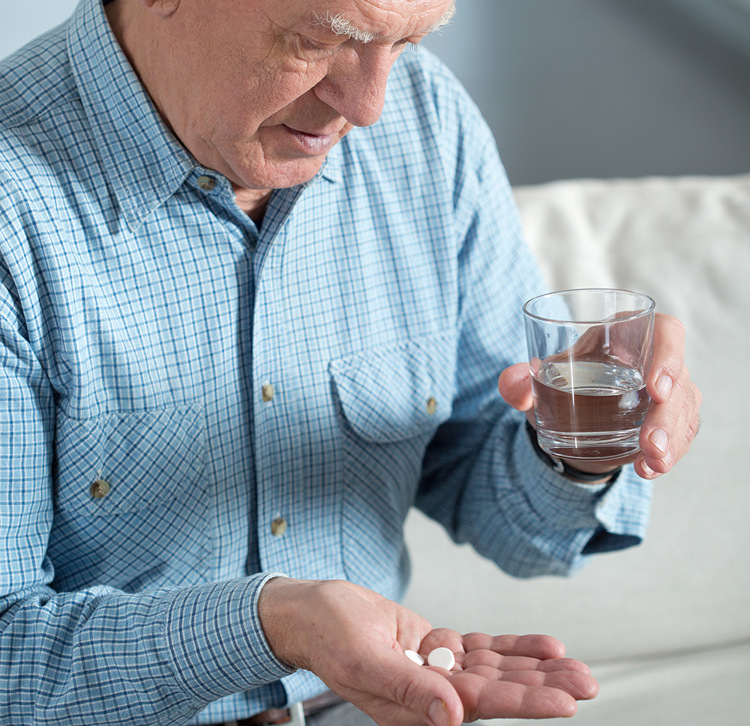
VS
reactive treatMENT OF disease
PRECISION PROACTIVE PURPOSE-DRIVEN HEALTH

Slide 28
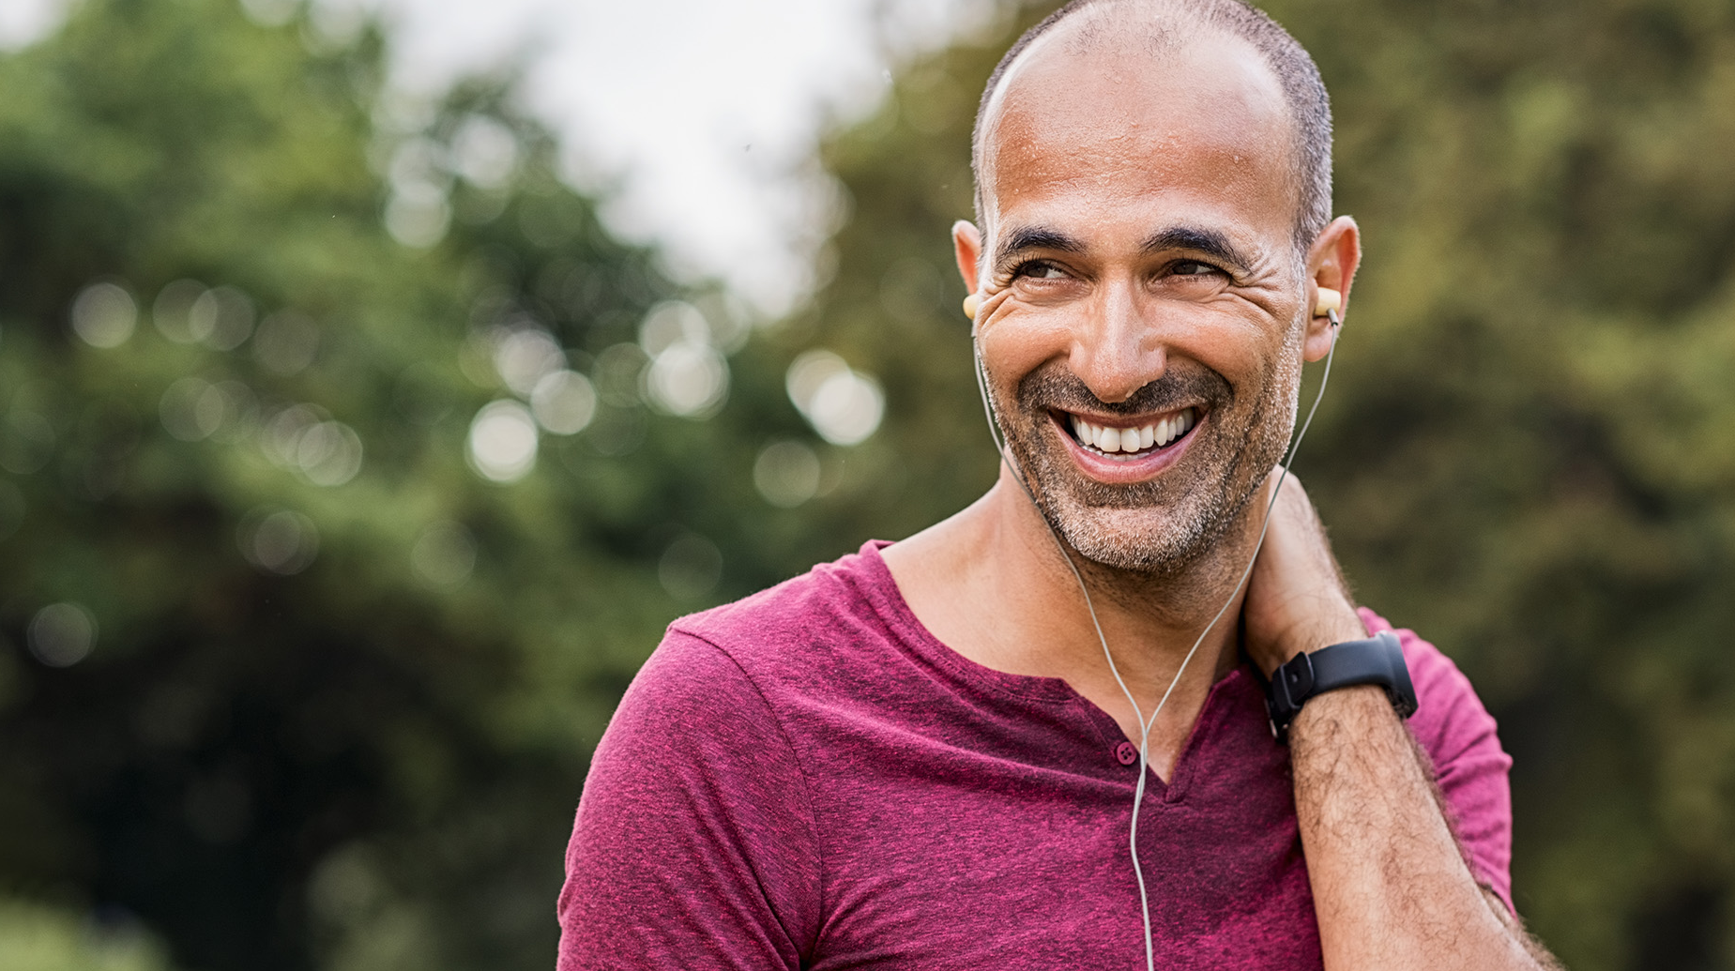
Thank you
Text TOOLKIT to 323-310-5223
for tools on reaching men

